Slide 1
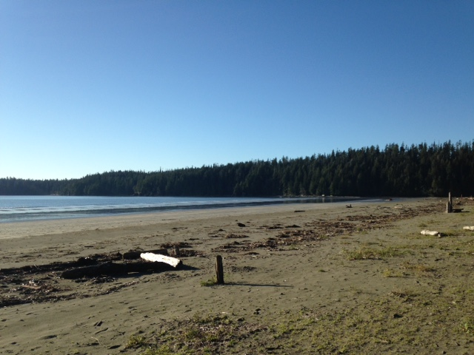
David Paul RPF, Authorizations Forester, South Island Resource District
Notes:
Hi and good morning;
Rhonda has asked me to remind you about the importance of RESULTS.
My name is David Paul and I am an Authorizations Officer here at South Island
I have been here since August 2015 and I am responsible for the district RESULTS as well as helping out with CP and RP’s. I am also very involved with Woodlots and Community Forest

Slide 2
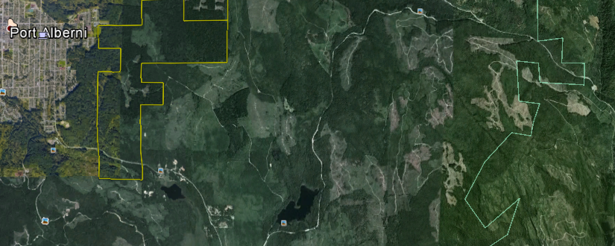
RESULTS and why they should matter to you as a forest manager
Notes:
As you know, we have all moved to a system’s world and we are all geo-referencing and linking our spatial data to inventory projections etc.
What I know is there are multiple licensees, and fragmented landscapes and I see more complexity in our land base
The other reality is that management of the tasks has also become more specialized and tasks either contracted or assigned to multiple employees.

Slide 3


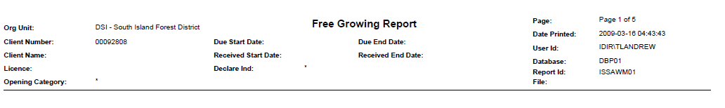
RESULTS
Reporting Silviculture Updates and Land Status Tracking System
Notes:
RESULTS is just one system in our Ministry tracking system
All ESF submissions create a place holder in RESULTS with Timber Mark and opening number
So RESULTS is building a data base – with or without your input

Slide 4
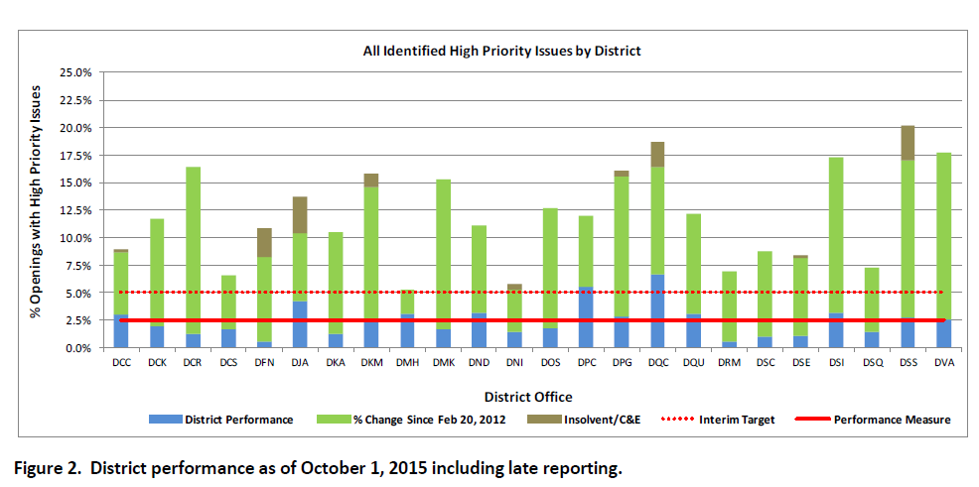
One year ago, Oct 2015
DSI - slightly over the 2.5%, but well below the 5% target,
Notes:
So; how are we doing;
When I arrived we were slightly above our target, but the green shows a lot of good work
I think you and Mark Palmer deserve credit for this progress
However if you look our other Vancouver Island Districts are doing better!
So, let’s look to our present stats (next slide)

Slide 5
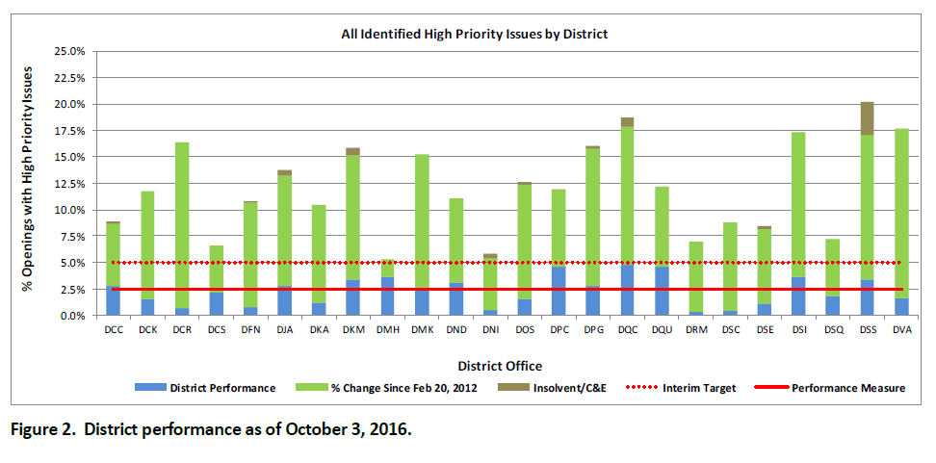
Latest performance figures
Current DSI – we are still slightly over the 2.5%, but well below the 5% target,
Notes:
We have all improved a bit, but South Island is lagging behind the other Vancouver Island districts
We have not made big improvements this year,
However – we have not got worse,
My conclusion is: Licensee’s continue to update RESULTS, but others are doing better

Slide 6
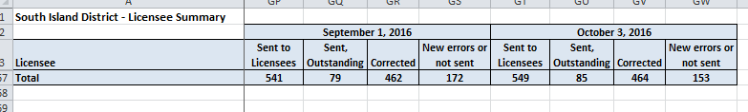
Licensee list of outstanding issues
Do you know who is responsible in your company for managing RESULTS?
Do you personally get the monthly updates?
Is your company staying up to date with this years activities?
Notes:
So: this year we will try to concentrate on compliance and get our numbers down;
How will we do that:
Make this presentation and ask:
Who manages your RESULTS data inputs? Are they supported in that work and do you think it is important
It is like safety – if you champion it, it will improve
Do you personally get involved in monitoring your companies RESULTS work
When you allocate resources, do you consider the time and effort needed for the task and
Do you see any value in this?

Slide 7
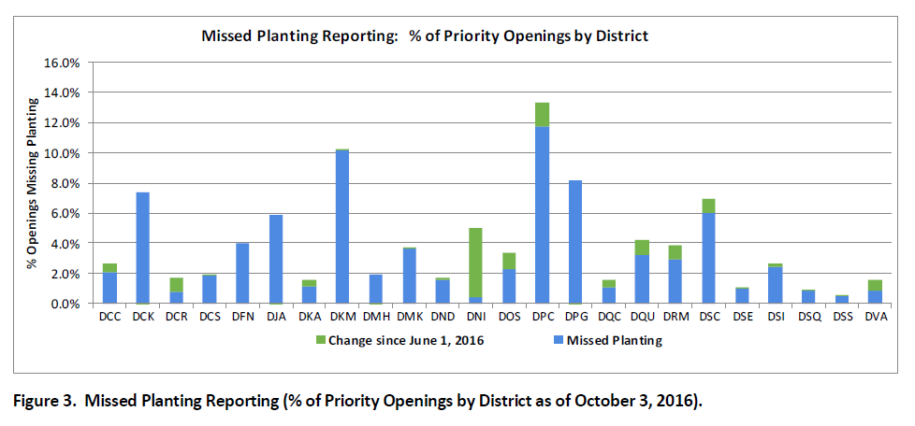
quality performance issues
Notes:
Our quick analysis shows that the main concern For South Island is planting reporting.
Not a surprise,

Slide 8

The Business Case
It’s part of your legal obligation
It is linked to our Corporate Reporting System
We use this information for Timber Supply Inventories.
Your AAC is linked to your inventory.
  More on this point
Notes:
So to recap;
It is part of your legal obligations
Our corporate reporting system links your FTA submission with a RESULTS opening
You maybe impacting your Timber Supply modelling if the information is not inputted in a timely manner
I feel like you know this stuff, but there is a direct benefit to you keeping up to date on your submissions

Slide 9
Conclusions
Timber supply is driven by your inventories,
Accurate and timely reporting of RESULTS activities benefits the licensee (Timber Supply).
one more thing: it enhances your ability to track in block WTRA commitments.
Notes:
In conclusion;
We are doing OK on the South Island and we could do better.
Three take home messages:
Inventories that are not showing you growing young class A seed are not helping your AAC
RESULTS is a database that can be utilized by the licensee to track operations for example in block Wildlife Tree Retention Areas
Unless you have questions about VDYP versus TIPSY, thanks you for your time this morning.

Slide 10
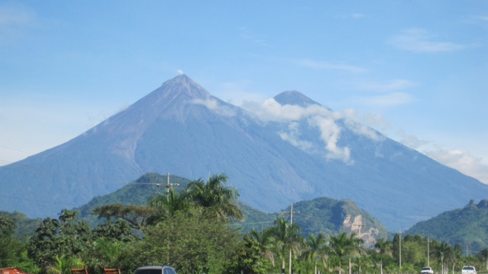
Thank you for listening.
David Paul Authorizations Forester

Slide 11
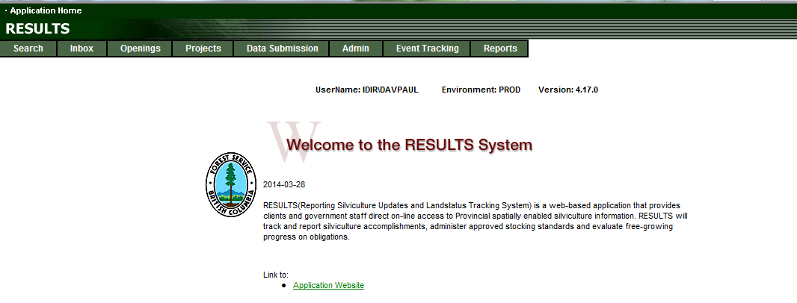
Data submitted to RESULTS under the Electronic Submission Framework ESF is explicitly linked to associated spatial information.

Slide 12
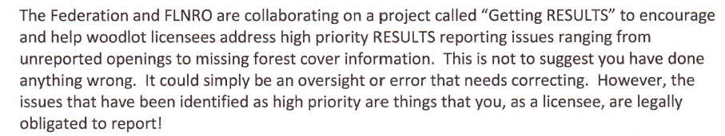

Legal obligation and what the Woodlot Federation is doing.
As a licensee, you too may be in an oversight position,
Remember the purpose of RESULTS:
Notes:
Woodlot clean up

Slide 13
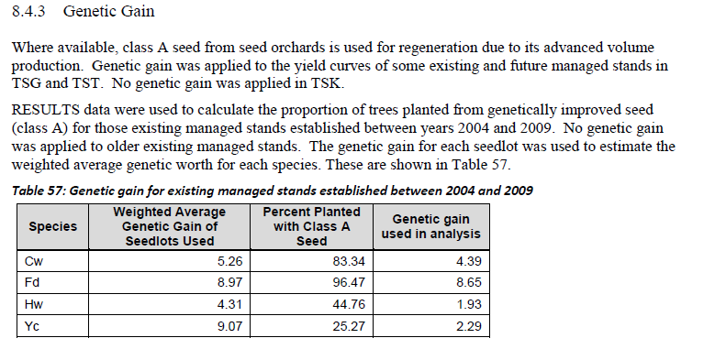
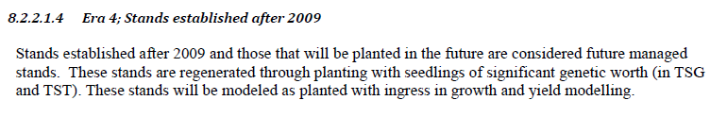
Again RESULTS data was used to increase yields
Stands are not established if they are not entered in RESULTS

Slide 14
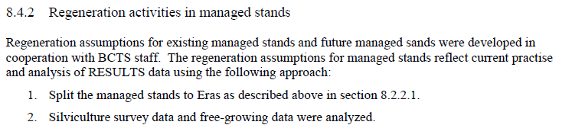
Ways to improve timber supply
Notice how the assumptions use RESULTS DATA

Slide 15

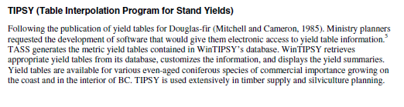
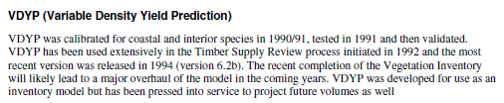
Timber supply

Slide 16
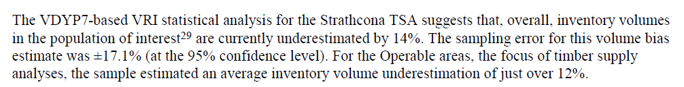
Vegetation Resource Inventory
By doing the work, and reporting your activities in RESULTS; you feed the TIPSY model which in turn effects your timber supply which effects your AAC.

